Slide 1


I
Building a Dashboard

Slide 2
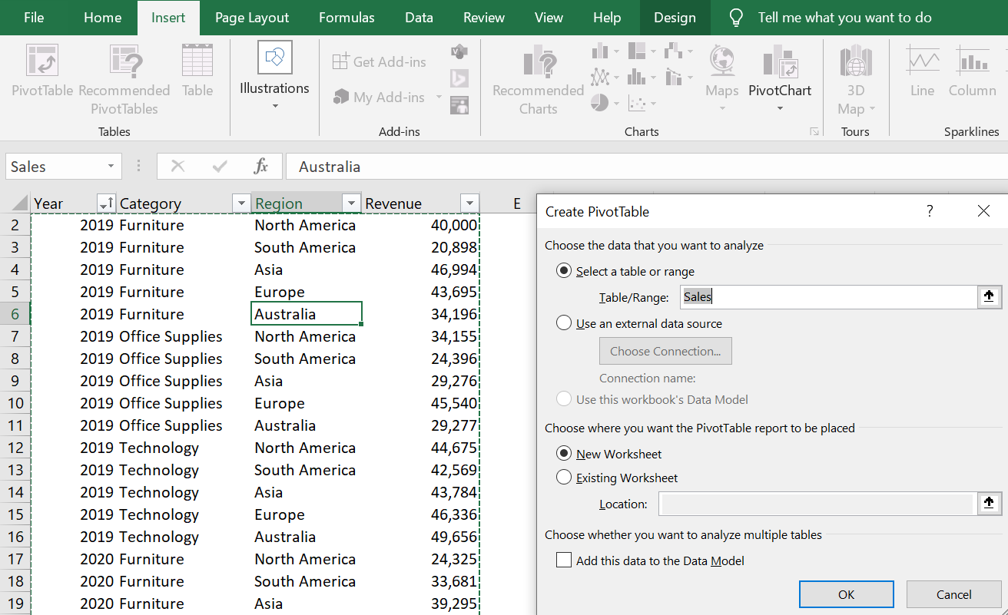

DASHBOARDS
Create a reader friendly dashboard for given conditions in KPI sheet
Open “Sales Dashboards.xlsx”.
Create Pivot table for given table.
www.dsa.az Bütün hüquqlar qorunur.
DATA SCIENCE ACADEMY
2

Slide 3
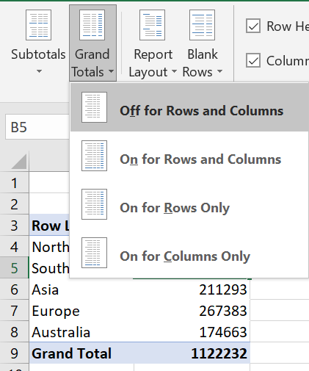
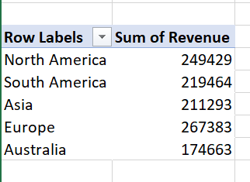

DASHBOARDS
Make a pivot table that shows sum of revenue by regions.
Give a name for PivotTable
Click any cell in the table
In order to delete Grand total, select Off for Rows and Columns from Grand Totals in Design tab
www.dsa.az Bütün hüquqlar qorunur.
DATA SCIENCE ACADEMY
3

Slide 4

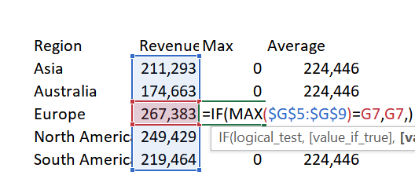
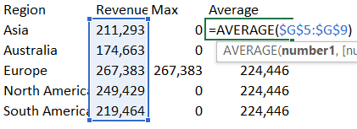

DASHBOARDS
Then copy pivot table and Paste Link in any place.
Find Average and Max of Revenue using formulas as shown in pictures.
Change Titles to Revenue, Max, Average.
Create Bar chart from table.
www.dsa.az Bütün hüquqlar qorunur.
DATA SCIENCE ACADEMY
4

Slide 5
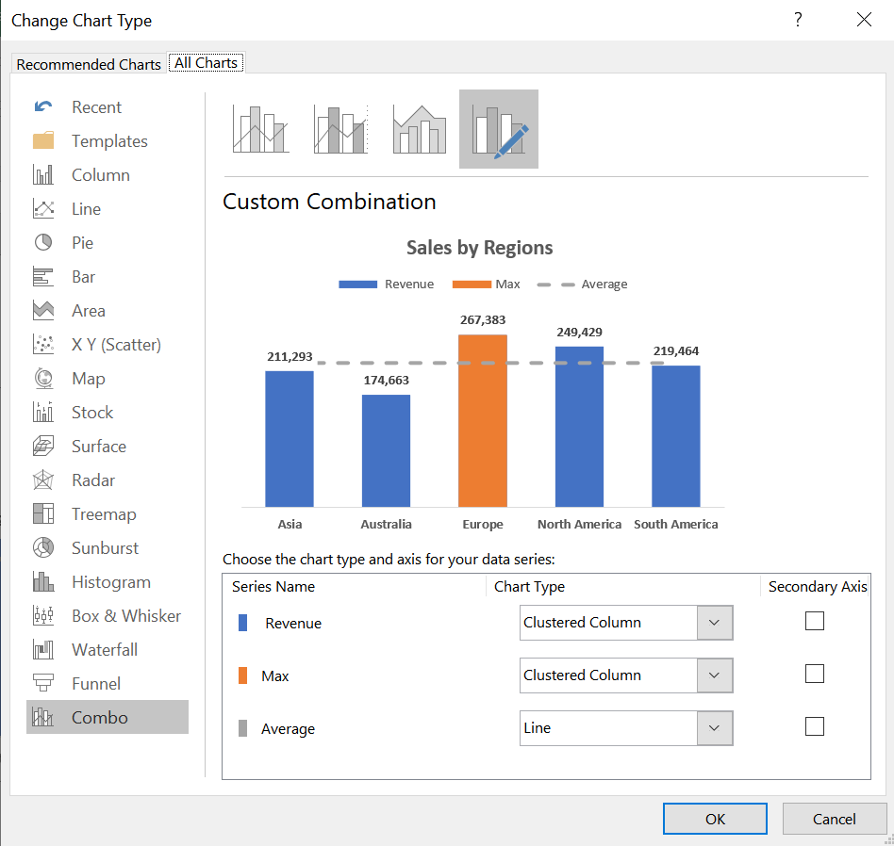
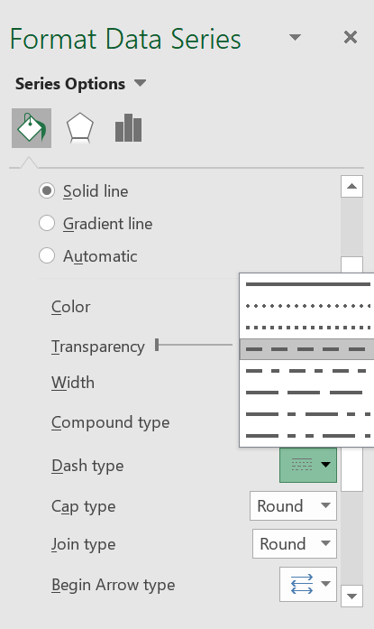
DASHBOARDS
Click on chart and select Change Chart type.
Then Set:
Revenue 🡪 Clustred Column
Max 🡪 Clustred Column
Average 🡪 Line
Double click the line in the chart in order to open the Format Data Series menu.
Choose dash as a Dash type in Format Data Series menu.
1
2
www.dsa.az Bütün hüquqlar qorunur.
DATA SCIENCE ACADEMY
5

Slide 6
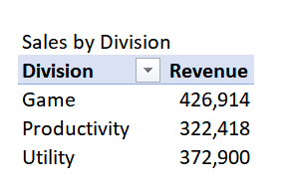
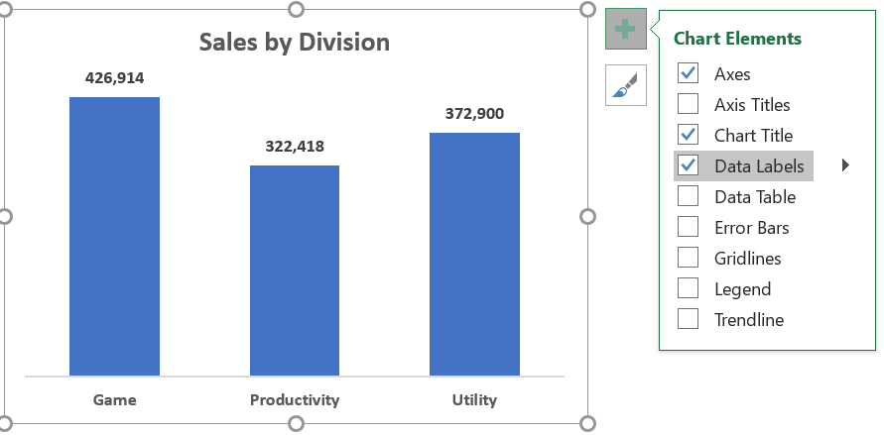
DASHBOARDS
Create new pivot table that shows sum of revenue by division.
Give a name for pivot table.
Create a bar chart from table
From chart elements choose chart title and data labels.
www.dsa.az Bütün hüquqlar qorunur.
DATA SCIENCE ACADEMY
6

Slide 7
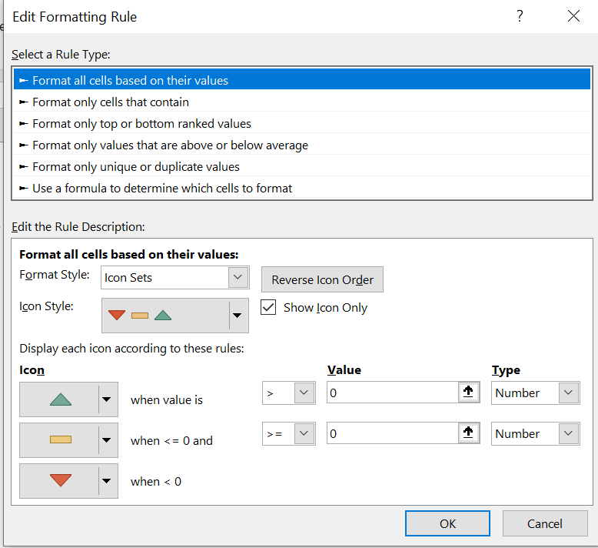
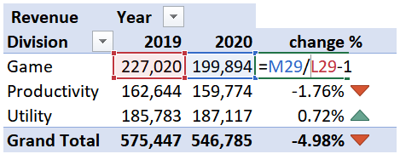
DASHBOARDS
Create new pivot table that shows sum of revenue by division.
Add Year to Columns in PivotTable Field List menu.
Give a name for Pivot Table
Add additional column and name it “change %”.
Calculate Percentage change in new column (Use the formula that shown in the picture).
Then format it by conditional formatting
2
1
www.dsa.az Bütün hüquqlar qorunur.
DATA SCIENCE ACADEMY
7

Slide 8
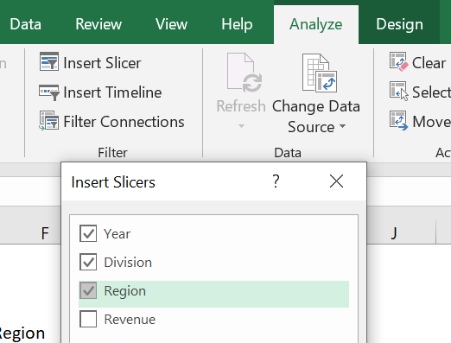
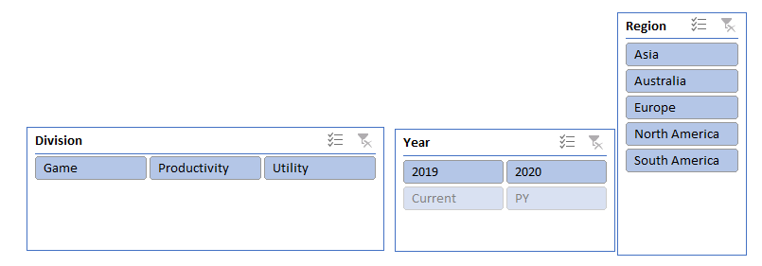
DASHBOARDS
Click Pivot Table.
Select Insert Slicer From Analyze tab.
Add Slicer for Region, Division and Year.
www.dsa.az Bütün hüquqlar qorunur.
DATA SCIENCE ACADEMY
8

Slide 9
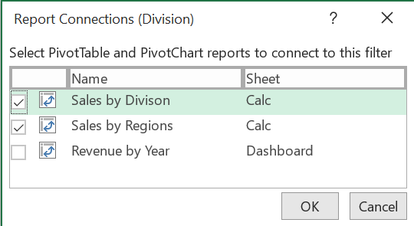
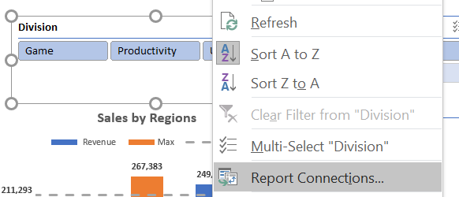
DASHBOARDS
Make connection between slicers and charts.
Right click the slicer and choose Report Connections.
Choose Sales by Division and Sales by Regions tables.
And do the same for other slicers.
2
1
www.dsa.az Bütün hüquqlar qorunur.
DATA SCIENCE ACADEMY
9

Slide 10
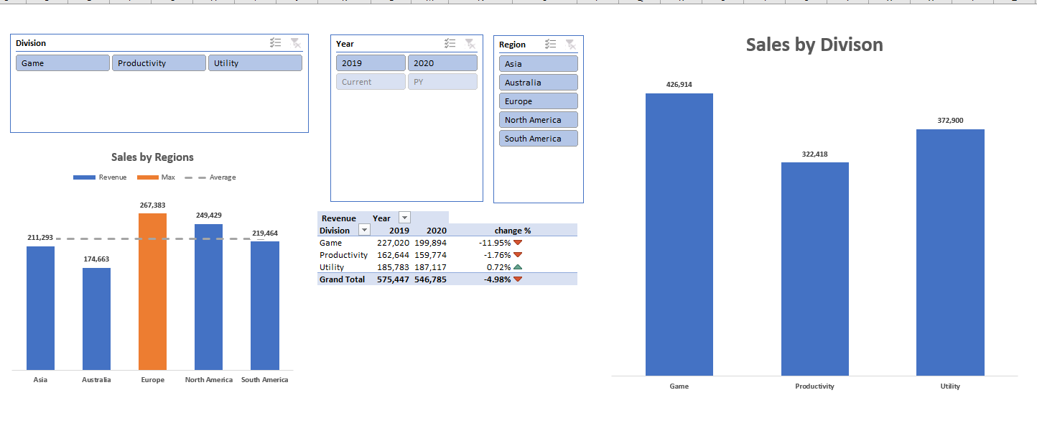
DASHBOARDS
Add all charts in one sheet
www.dsa.az Bütün hüquqlar qorunur.
DATA SCIENCE ACADEMY
10

Slide 11
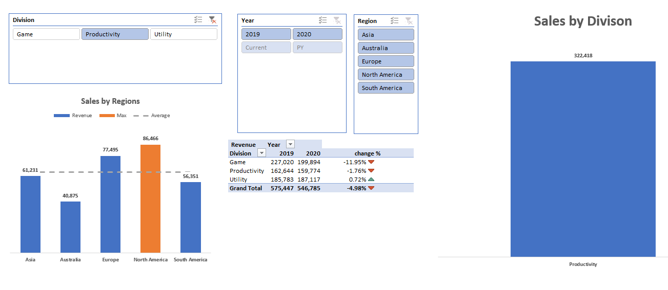
DASHBOARDS
Choose one of the divisions. It will make changes in all charts
www.dsa.az Bütün hüquqlar qorunur.
DATA SCIENCE ACADEMY
11

Slide 12


Thank you!

